Slide 1

Facebook Marketplace Case Project
Analyze social media engagement data for Thai fashion and cosmetics brands to optimize customer interaction strategies.
A case study carried out by Aryan Singhal.

Slide 2

OUTLINE
Introduction
Data cleaning
Key visualizations
K-Means Clustering

Slide 3
Introduction
Summary of Dataset
Column Descriptions
The dataset offers insights into social media engagement for Thai fashion and cosmetics sellers, tracking reactions, comments, and shares. Analyzing post types and timing helps businesses understand and optimize customer engagement strategies.
status_id: Post identifier.
status type: Post type.
status_published: Date and time.
num_reactions: Total reactions.
num_comments: Total comments.
num_shares: Total shares.
num_likes: ‘Like’ reactions.
num_loves: ‘Love’ reactions.
num_wows: ‘Wow’ reactions.
num_hahas: ‘Haha’ reactions.

Slide 4

Data cleaning
Resolving issues of messy and dirty data

Slide 5
Issues with Dataset
Dirty Data
Messy Data
Validity issues like wrong data-type assigned.
Unnecessary columns

Slide 6
Key visualizations
Visualizations from the dataset

Slide 7
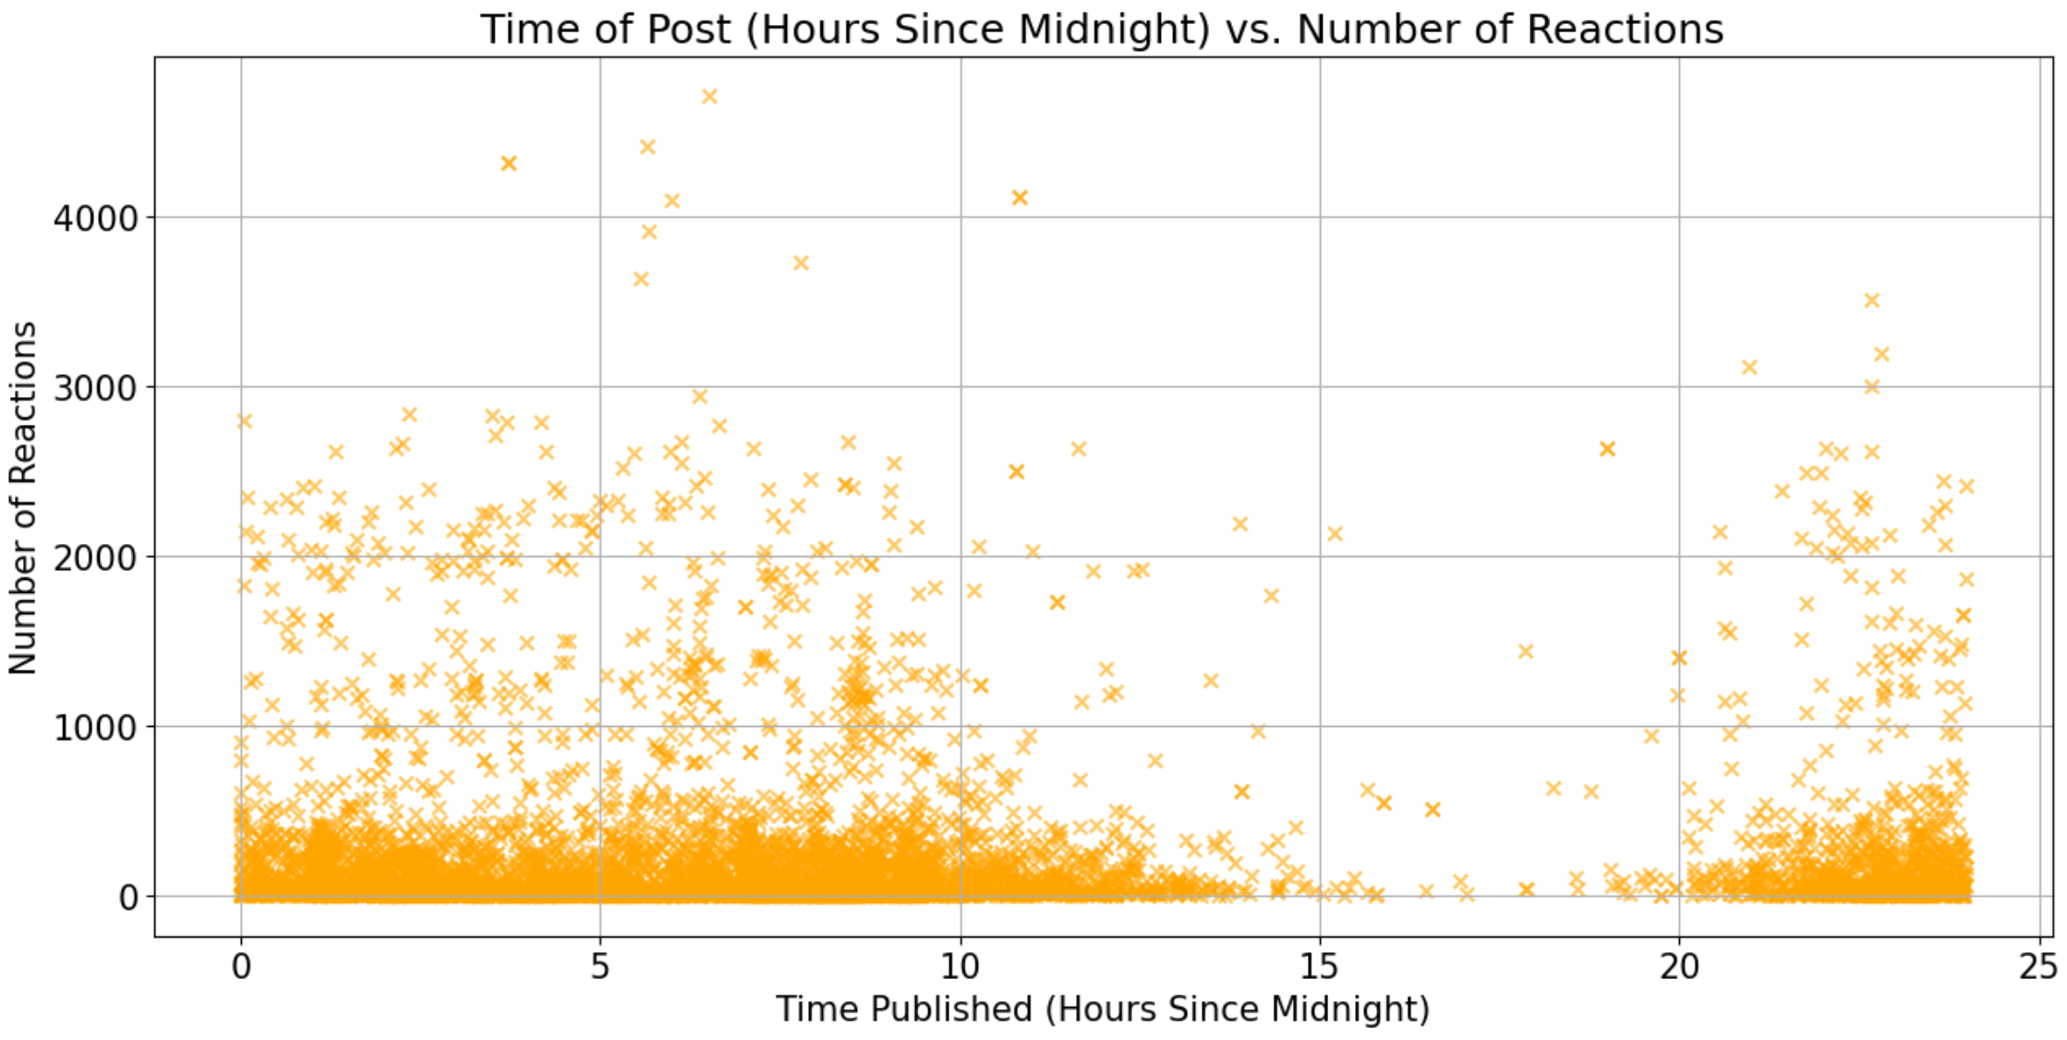
Chart 1: Reactions vs Upload Time
Reactions are generally spread throughout the day, with slightly higher concentra-tions in the early morning and late evening hours.

Slide 8
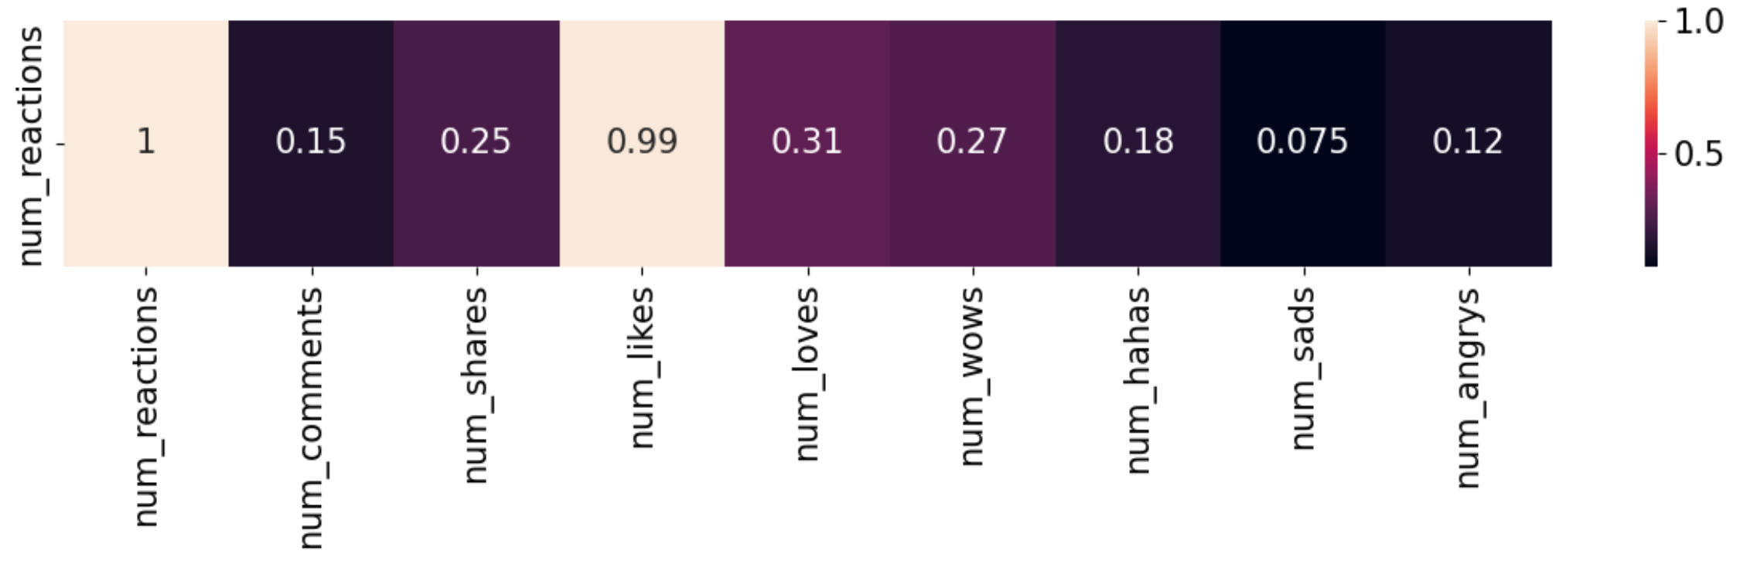
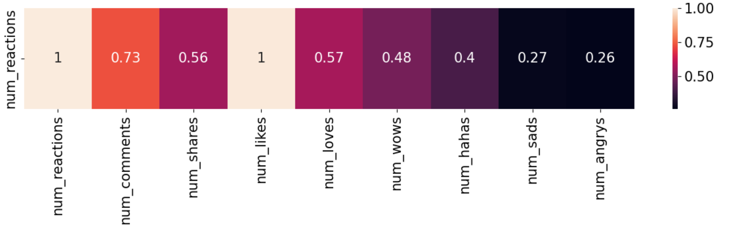
Chart 2: Correlation of Metrics
Pearson Coefficient
Reactions and likes are nearly perfectly correlated. Reactions and comments, and reactions and shares, start with strong correlations at low engagement, but both weaken as engagement increases.
Spearman Coefficient

Slide 9
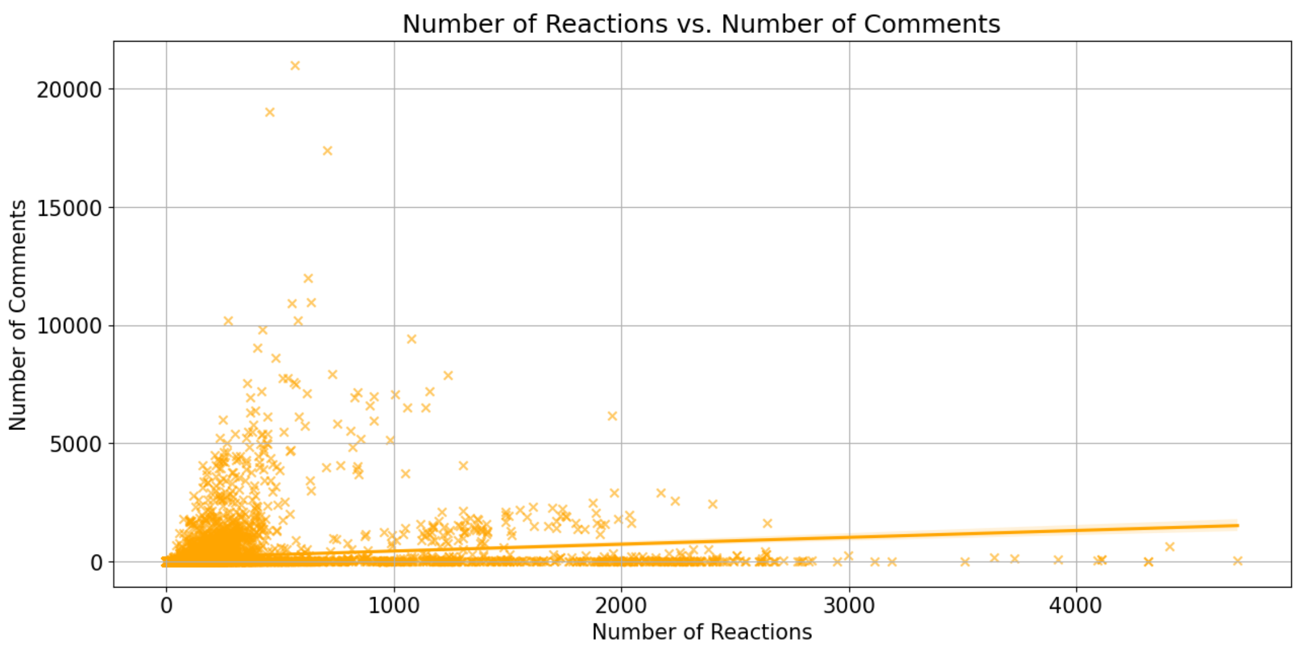
Chart 3: Reactions vs Comments
Reactions and comments strongly correlate at low engagement levels, but this weakens as engagement rises, leading to a weak positive correlation overall.
(Pearson: 0.15,
Spearman: 0.73)

Slide 10
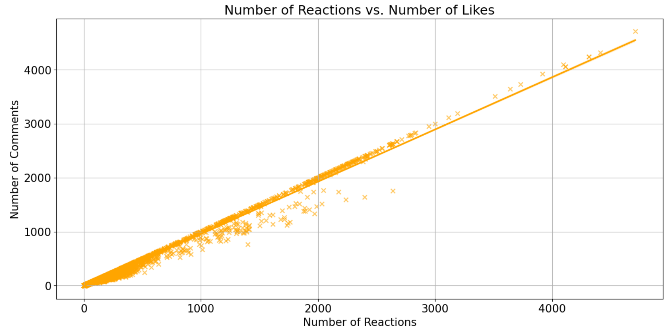
Chart 4: Reactions vs Likes
Reactions and likes have a nearly perfect linear relationship, increasing together at an equivalent rate.
(Pearson:0.99, Spearman:1)

Slide 11
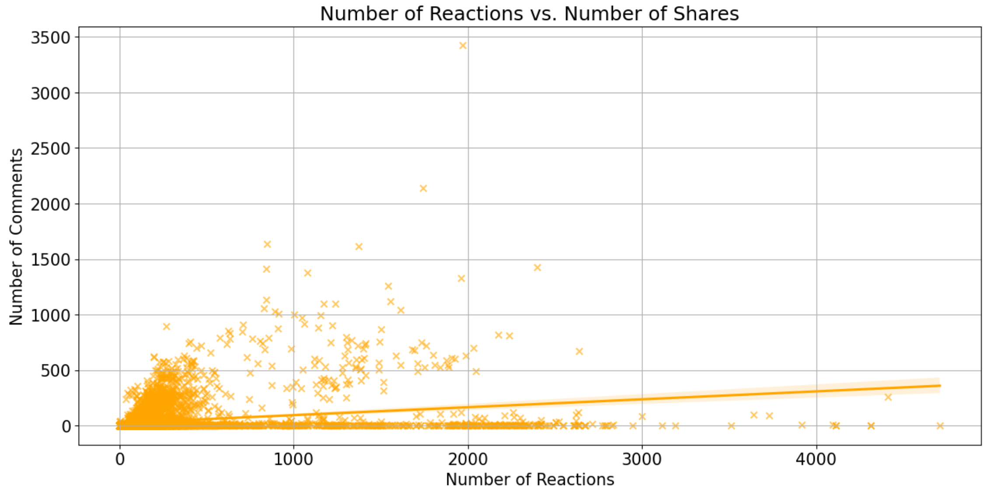
Chart 5: Reactions vs Shares
Reactions and shares are positively correlated at low engagement levels, but declines to a weak positive correlation as engagement increases
(Pearson: 0.25, Spearman: 0.56).

Slide 12
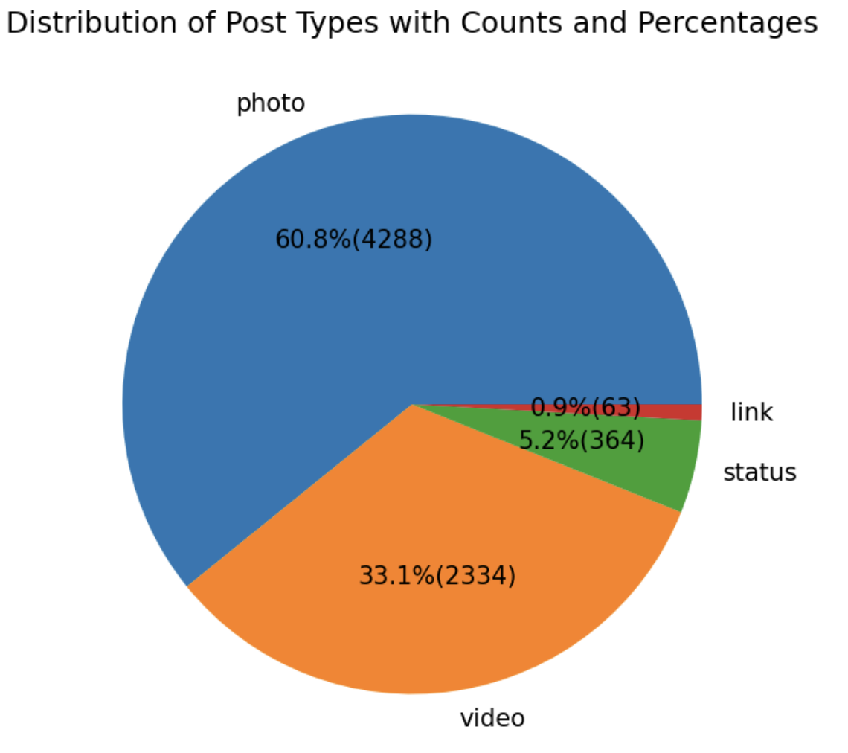
Chart 6: Post-Type Distribution
The dataset consists of 60.8% photos (4288 posts), 33.1% videos (2334 posts), 5.2% statuses (364 posts), and 0.9% links (63 posts).

Slide 13
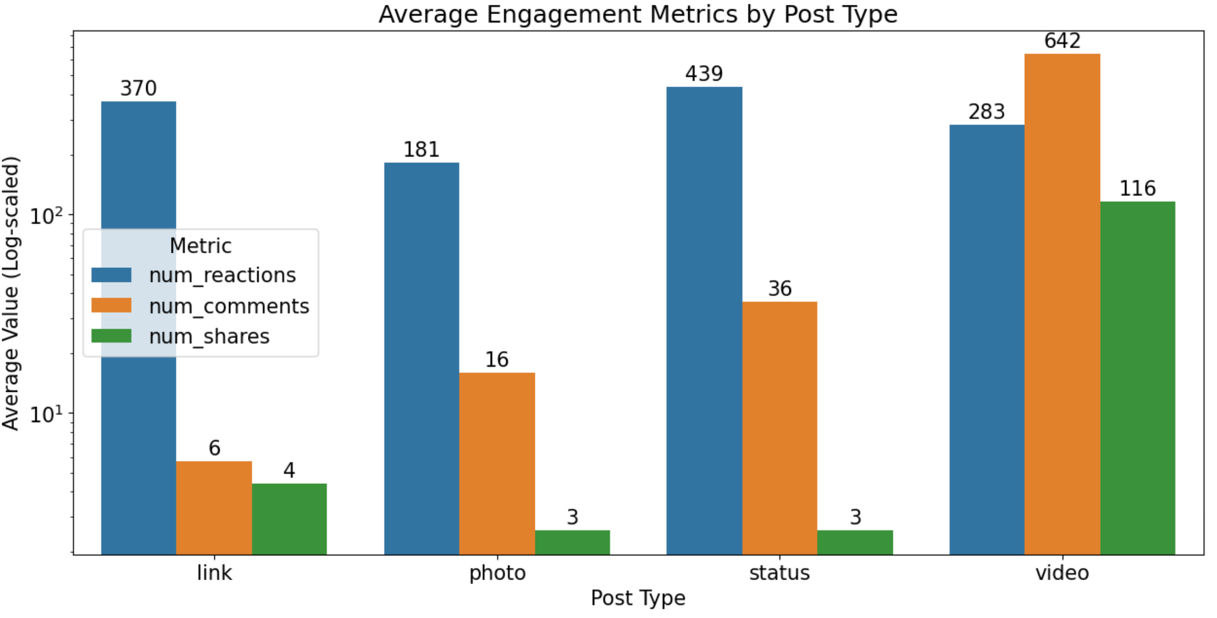
Chart 7: Average Metrics vs Post-Type
Status posts have the most reactions (439), while photos have the fewest (181). Videos get the most comments (642) and shares (116), while links have the least engagement with 6 comments and 4 shares.

Slide 14

K-Means Clustering

Slide 15
Workflow
Train-Test Split
One-hot Encoding (Categorical)
Data Scaling (Numerical)
Fit K-Means Model
Elbow Method for Optimal Clusters
Refit K-Means with Optimal Clusters

Slide 16
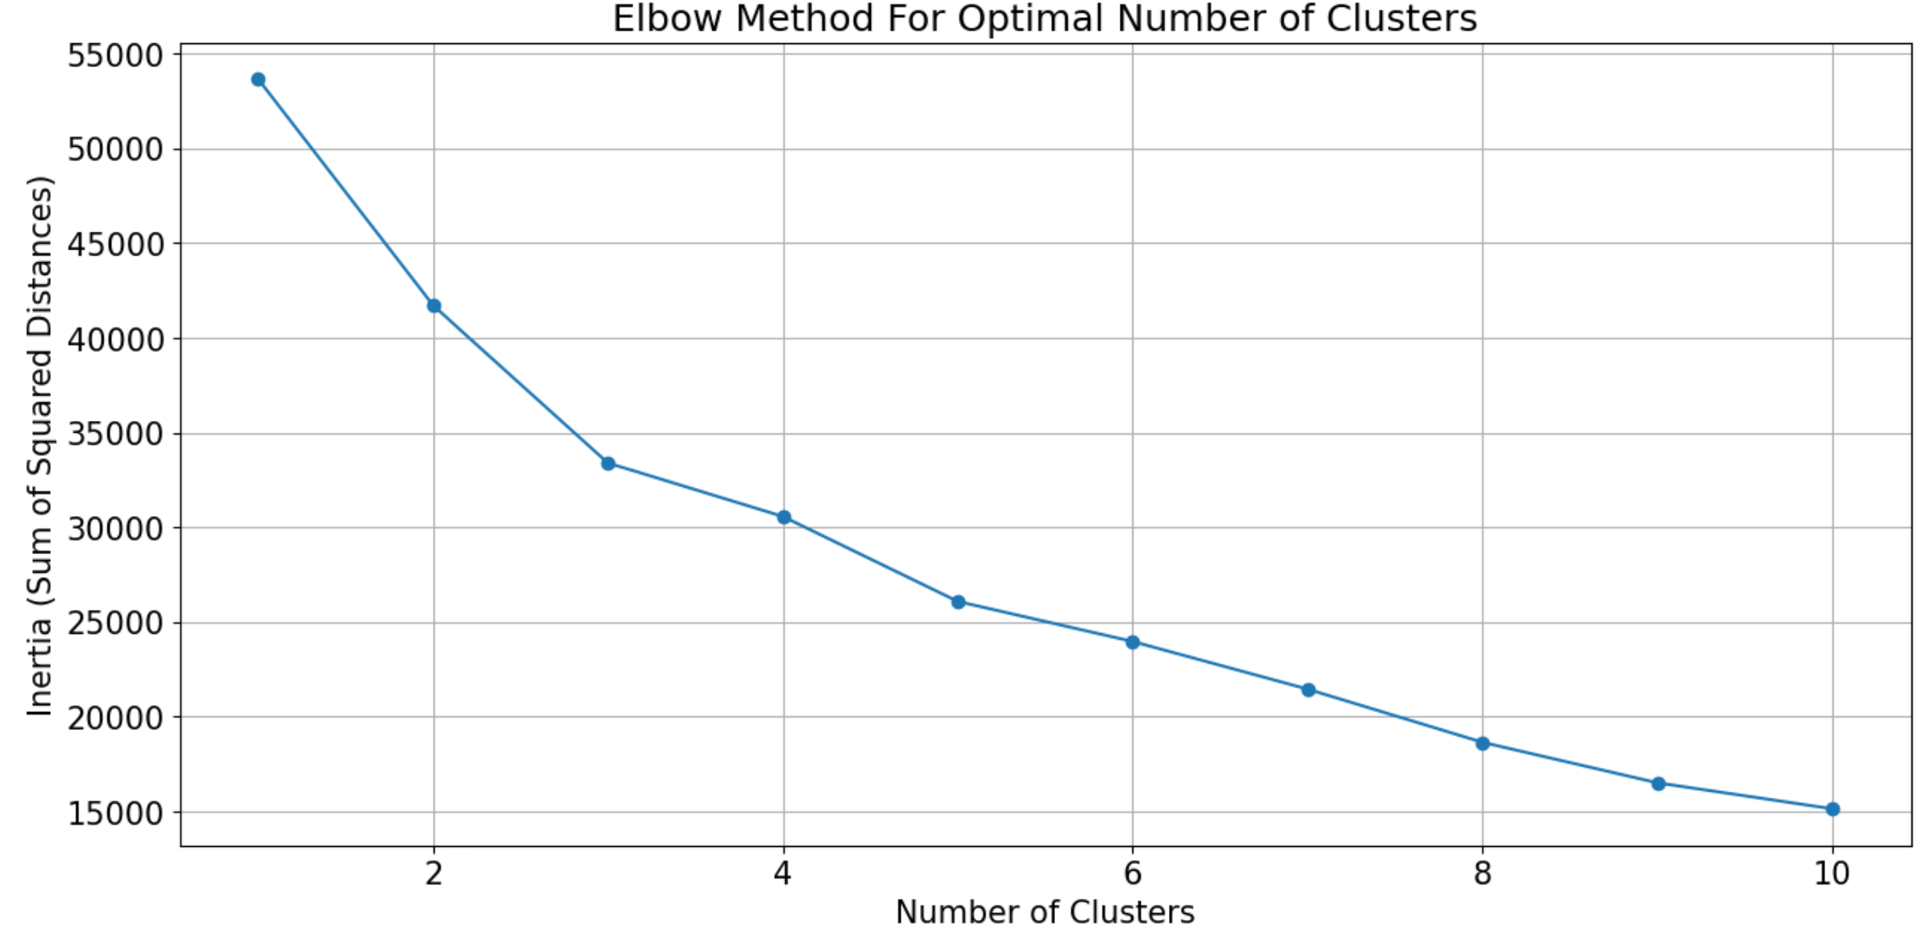
Elbow Method to find optimal Clusters
K=3

Slide 17
THANK YOU!

